Slide 1
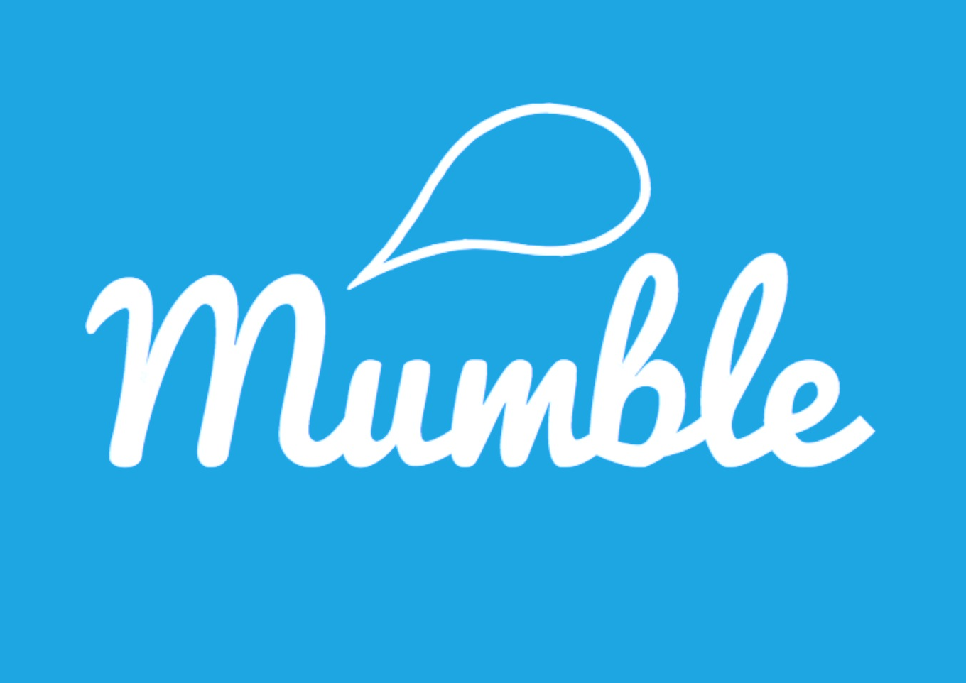
Investor Presentation
Prepared for: Amnon Bar-Tur
Date: 18/10/14

Slide 2
Contents
1
Market Opportunity
2
The Product
3
Key Features
4
Competition
5
Go-To-Market Strategy
6
What We Need
7
Executive Summary

Slide 3
Market Opportunity
The Future of Mobile Apps are/will be currently driven by three key trends:
(Gartner, Wired, TechCrunch, Juniper 2014)
mumble
Tweets
Anonymous
Proximity

Slide 4
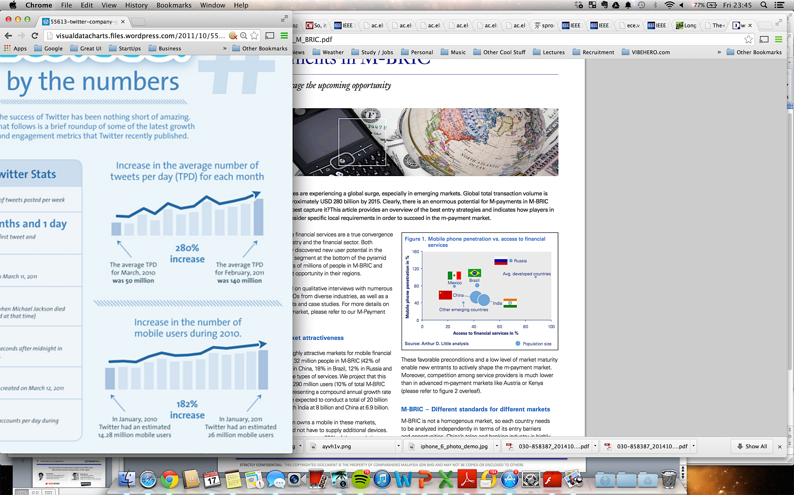
Market Opportunity
Increase in Average Tweets Per Day each Month
280% Increase in 9 months
Mar 2012 (50m) – Feb 2012 (140m)
Tweets
# Tweet Count
1 billion a week
150 million a day
640 a second
Increase in Mobile Users
Per Month
182% Increase in 12 months
Jan 2011 (14m) – Jan 2011 (26m)
Notes:
Tweets
Slide on each
Graph on each
Popularity
Market

Slide 5




Market Opportunity
Anonymous
“Anonymity is ingrained in the human experience but hasn’t been in social apps until now,” (Sept 2014)
“There’s this huge space, all the experiences people have and don’t really share.” (June 2014)
“a very important human need: the freedom to share our true thoughts anonymously and without fear of judgment” (Aug 2014)
“The latest revolution in mobile apps” (Sept 2014)
Notes:
Anonymous
Why people don’t want to use their name
Why its growing
India, South America

Slide 6


Market Opportunity
71%
of all Ad spend will be on location based apps (Gartner 14)
Proximity
$43bn
valuation of location based application market by 2019 (Juniper 14)
Notes:
Proximity
Why Location?
Location, Location, Location
Find out their team

Slide 7
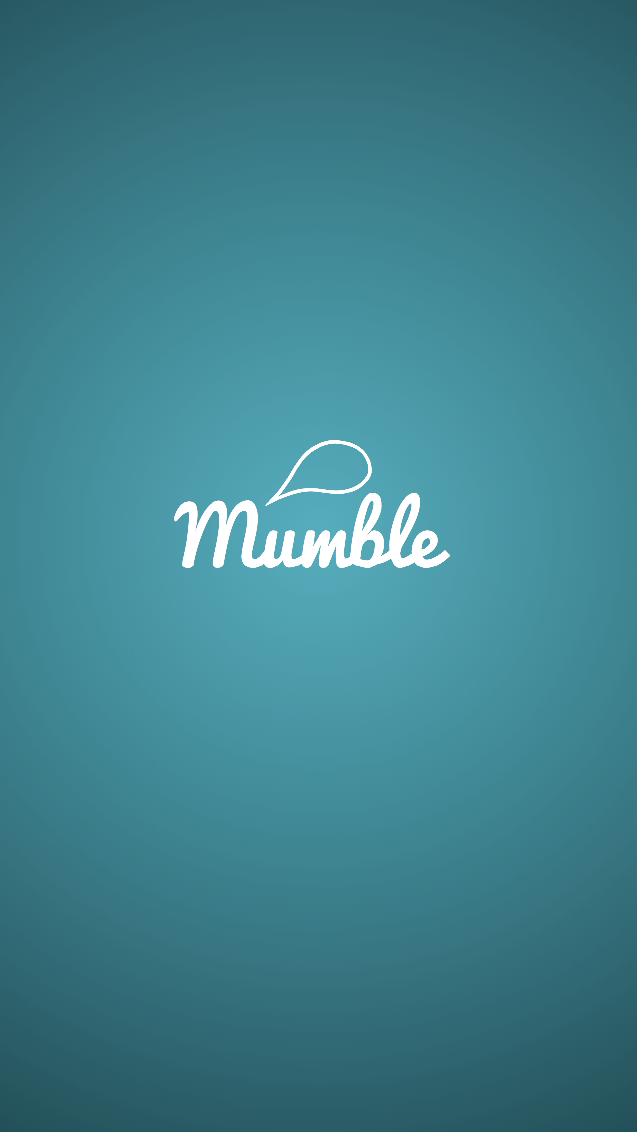
The Product
mumble is free to download from both the iOS & Android Store
No Login is required
Content Controllers Can Access user data and unique identifier if necessary
Users must allow access to their location services

Slide 8
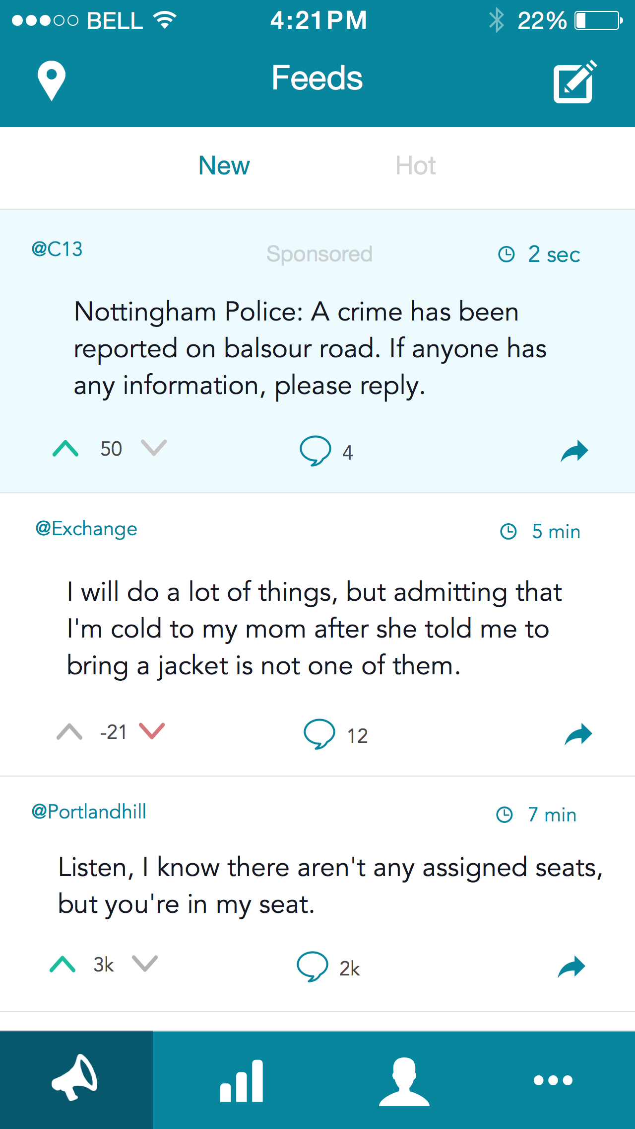
The Product
A feed of news from the surrounding location according to a predefined radius
Paid, Sponsored news highlighted in Blue
Vote Up (Like) Down (Dislike)
Reply and Respond
Share with Friends on Social Platforms
View Location of Posts
Flag inappropriate Posts

Slide 9
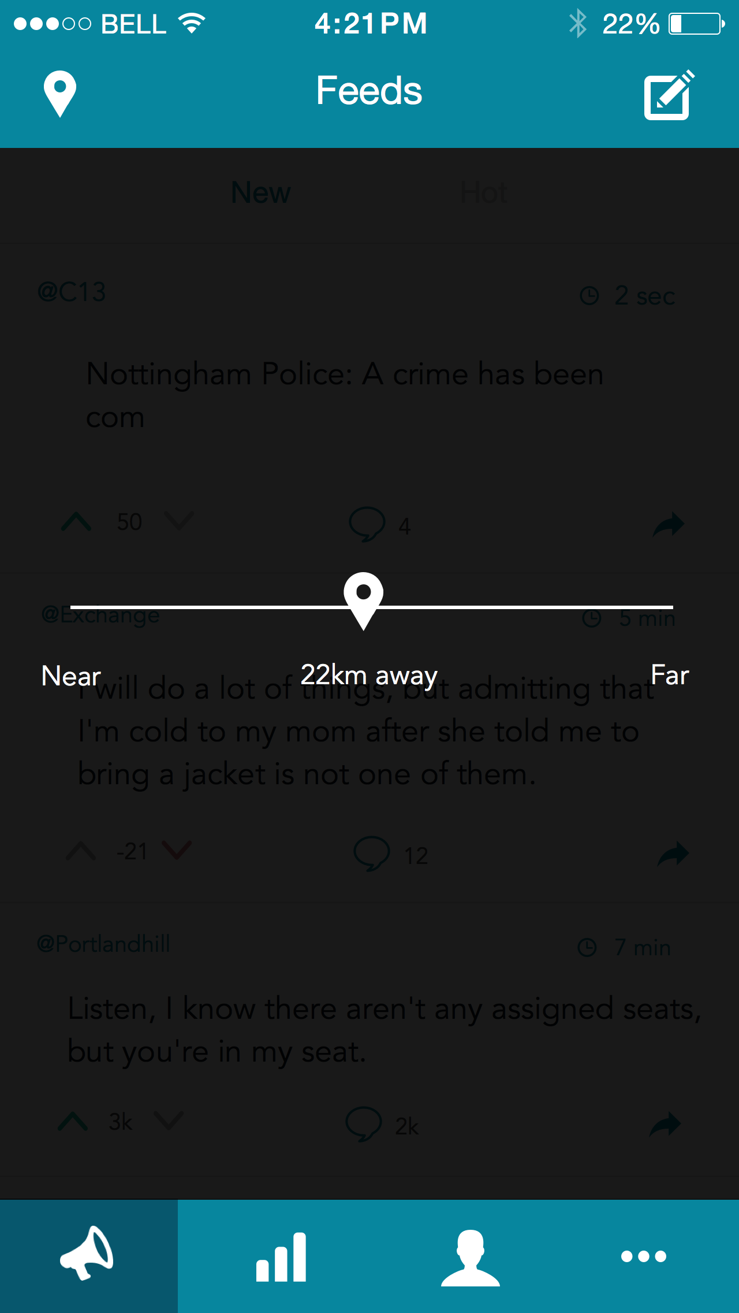
The Product
Users can redefine their feed range from 1km to 50km
Once selected, users return to an updated feed of results
Range will default on a radius which provides an adequate number of mumbles for the user.

Slide 10
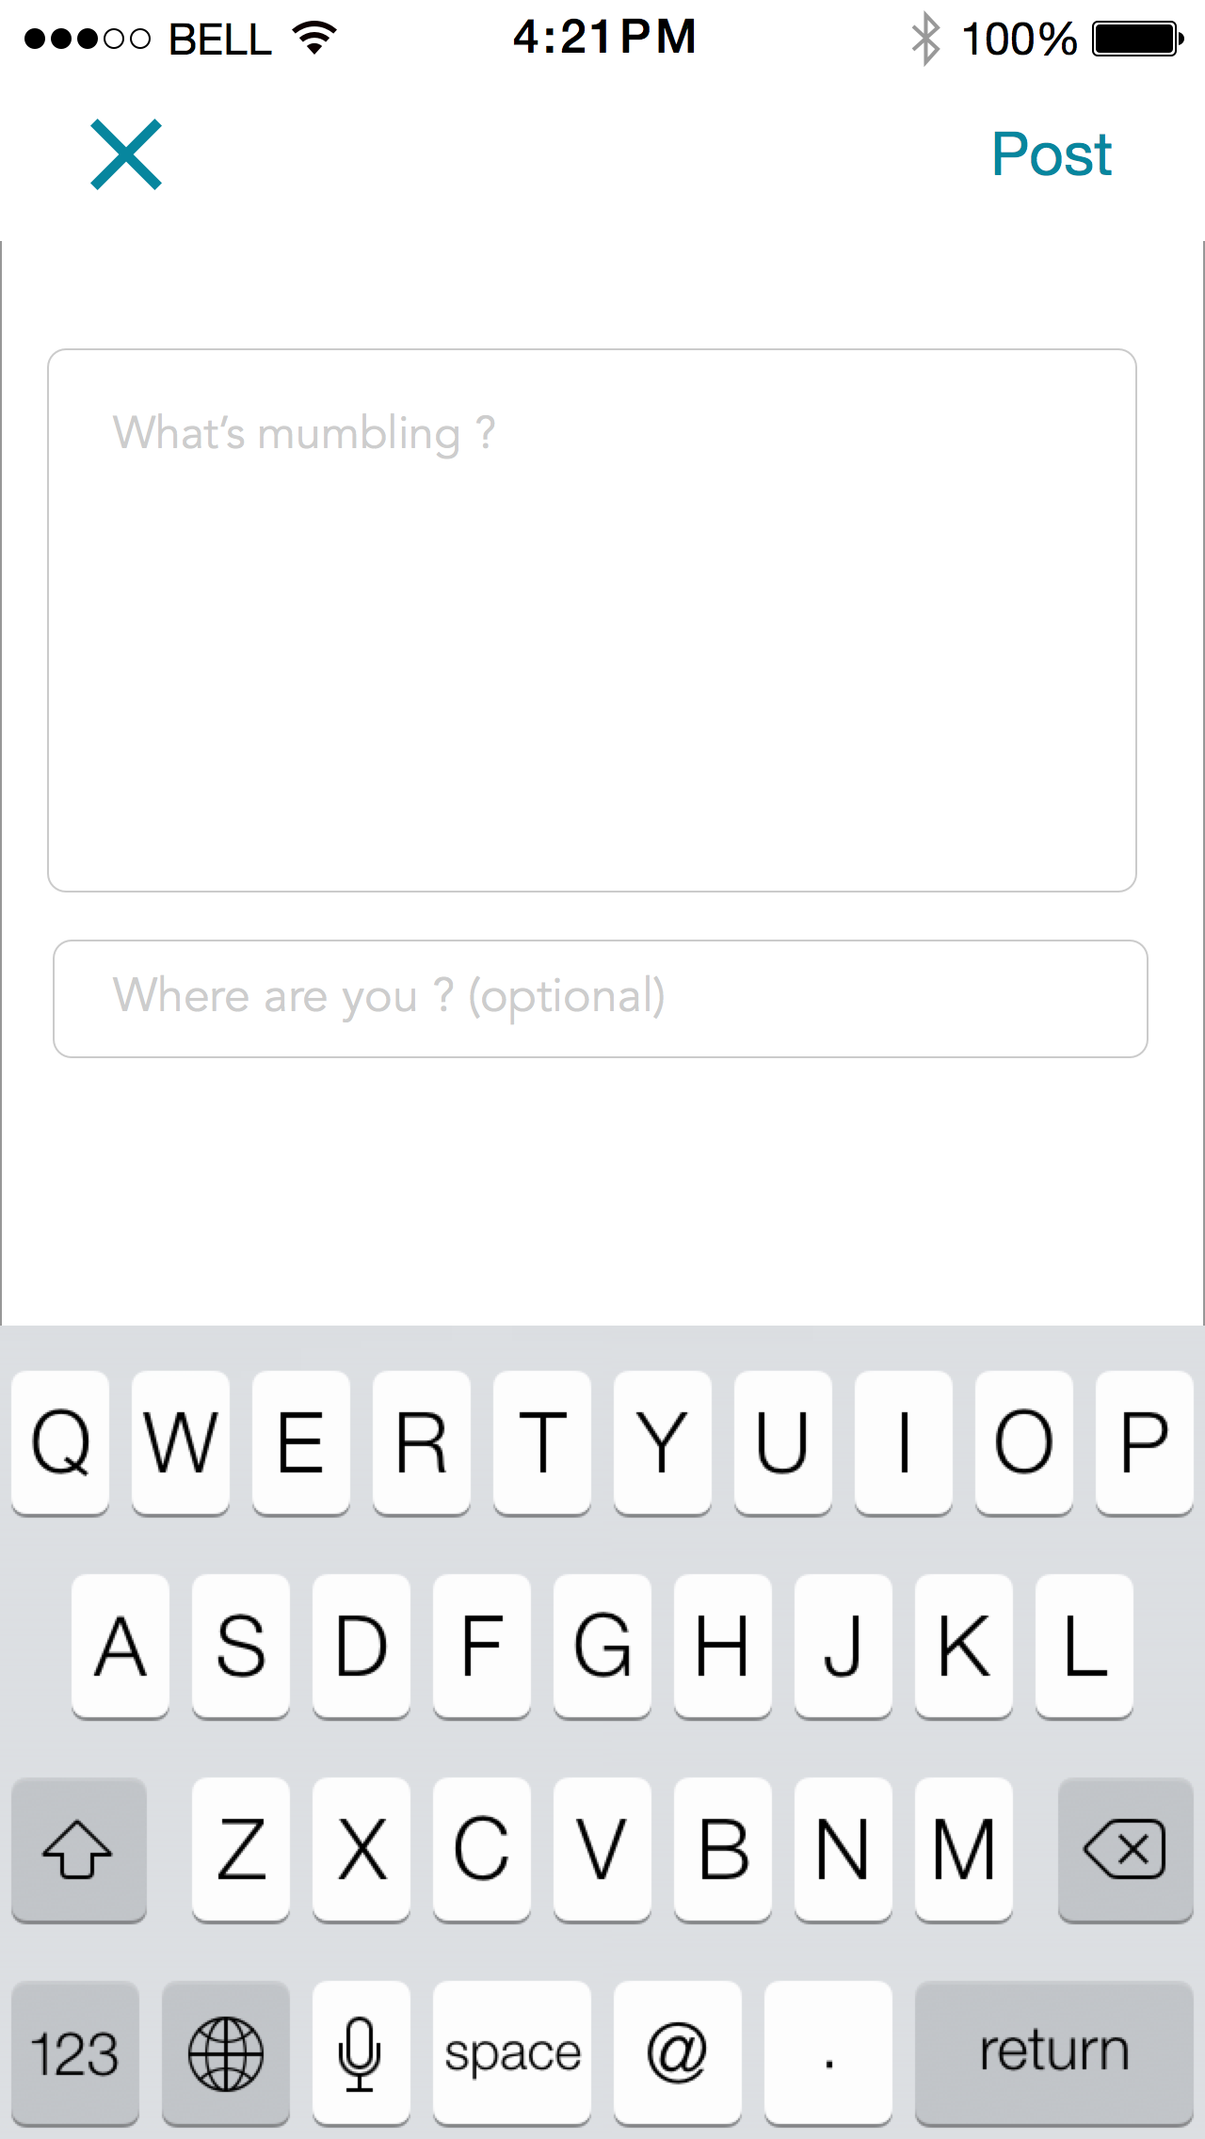
The Product
Users can post mumbles using the “+” button
mumbles are limited to 150 characters
mumblers are warned that mumbles must abide to strict guidelines and rules
mumbles are monitored by the content team 24/7
Location is automatically sourced, users then find the landmark closest to them

Slide 11


Competition
Tweet
Anonymous
Proximity
Operations
Yik Yak
US Only
150 Universities
Secrets
US, Europe
Whisper
US, Europe
Cloaq
US Only
FourSquare
Global
Twitter
Global

Slide 12

Competition
Key Facts
Name: Yik Yak
Founded: Nov 2013
Launched: April 2014
HQ: Atlanta
Operating in: US Only
Employees: 15
Funding $15m (Azure CP, Tim Draper)
“5% of 17-26 year olds use Yik Yak every day”
(MacAfee)

Slide 13
Go to Market Strategy
Team Profile
Confidence in launch
Approach to market (Sales, Marketing, Content)
Universities – Stats…Students
Examples of use case
Relevance
Properties, lectures, nightclubs
European Universities
Asia etc…
Moderation – Content generation and screening

Slide 14
Investment Need
Infrastructure – Variable – Low Risk
Advertising Spend / Marketing / PR
What we need the investment for…
Appendix – Financials Aspect
Metrics– CPU, Ratios, Advertising, Eyeballs
Equity Offer

